Slide 1
A Sleep Tracking App for a Better Night's Rest
PRESENTED BY :
LOGESWARAN B
36A989DA0866716B9004B9DFCFFE594C
MUTHUPANDIYAN K
4295CF347661613B2E14623FF4B65C3D

Slide 2
Project Overview :
Sleep Track is a mobile application designed to help users monitor and improve their sleep quality through personalized insights and recommendations. By tracking sleep patterns, providing educational resources, and offering tools for relaxation, SleepTrack aims to empower users to achieve restorative sleep and enhance their overall well-being.

Slide 3
Objectives :
Track Sleep Patterns: Allow users to log their sleep duration, quality, and any disturbances.
Analyze Sleep Data: Use algorithms to analyze sleep trends and provide insights into users' sleep habits.
Personalized Recommendations: Offer tailored advice for improving sleep based on individual data.
Educational Resources: Provide articles, tips, and videos on sleep hygiene and relaxation techniques.
Integration with Wearables: Sync with wearable devices (like smartwatches and fitness trackers) for automatic sleep tracking.

Slide 4
Key Features :
User Profiles: Users can create profiles to log sleep data, set sleep goals, and track progress over time.
Sleep Journal: A feature that allows users to record their sleep experiences, including pre-sleep activities, stress levels, and caffeine intake.
Sleep Analysis: Visualizations of sleep patterns over time, including duration, quality, and disturbances.
Relaxation Tools: Guided meditations, calming music, and breathing exercises to help users wind down before sleep.

Slide 5
Smart Alarm: An intelligent alarm that wakes users during light sleep phases for a more refreshing experience.​
Community Forum: A space for users to share experiences, tips, and support with each other.​
Reminders & Notifications: Gentle nudges to maintain a consistent sleep schedule and healthy sleep habits.​
Target Audience​
General Public: Individuals looking to improve their sleep quality and overall health.​
Students: Those managing busy schedules and seeking effective sleep strategies.​
Professionals: Individuals with demanding jobs who may experience sleep disturbances.​

Slide 6
CODE :
package com.example.projectone
import android.content.Context
import androidx.room.Database
import androidx.room.Room
import androidx.room.RoomDatabase
@Database(entities = [TimeLog::class], version = 1, exportSchema = false)
abstract class AppDatabase : RoomDatabase() {
abstract fun timeLogDao(): TimeLogDao

Slide 7
companion object {​
private var INSTANCE: AppDatabase? = null​
fun getDatabase(context: Context): AppDatabase {​
val tempInstance = INSTANCE​
if (tempInstance != null) {​
return tempInstance​
}​
synchronized(this) {​
val instance = Room.databaseBuilder(​
context.applicationContext,​
AppDatabase::class.java,​
"app_database"​
).build()​
INSTANCE = instance​
return instance​
}​
}​
}​
}

Slide 8
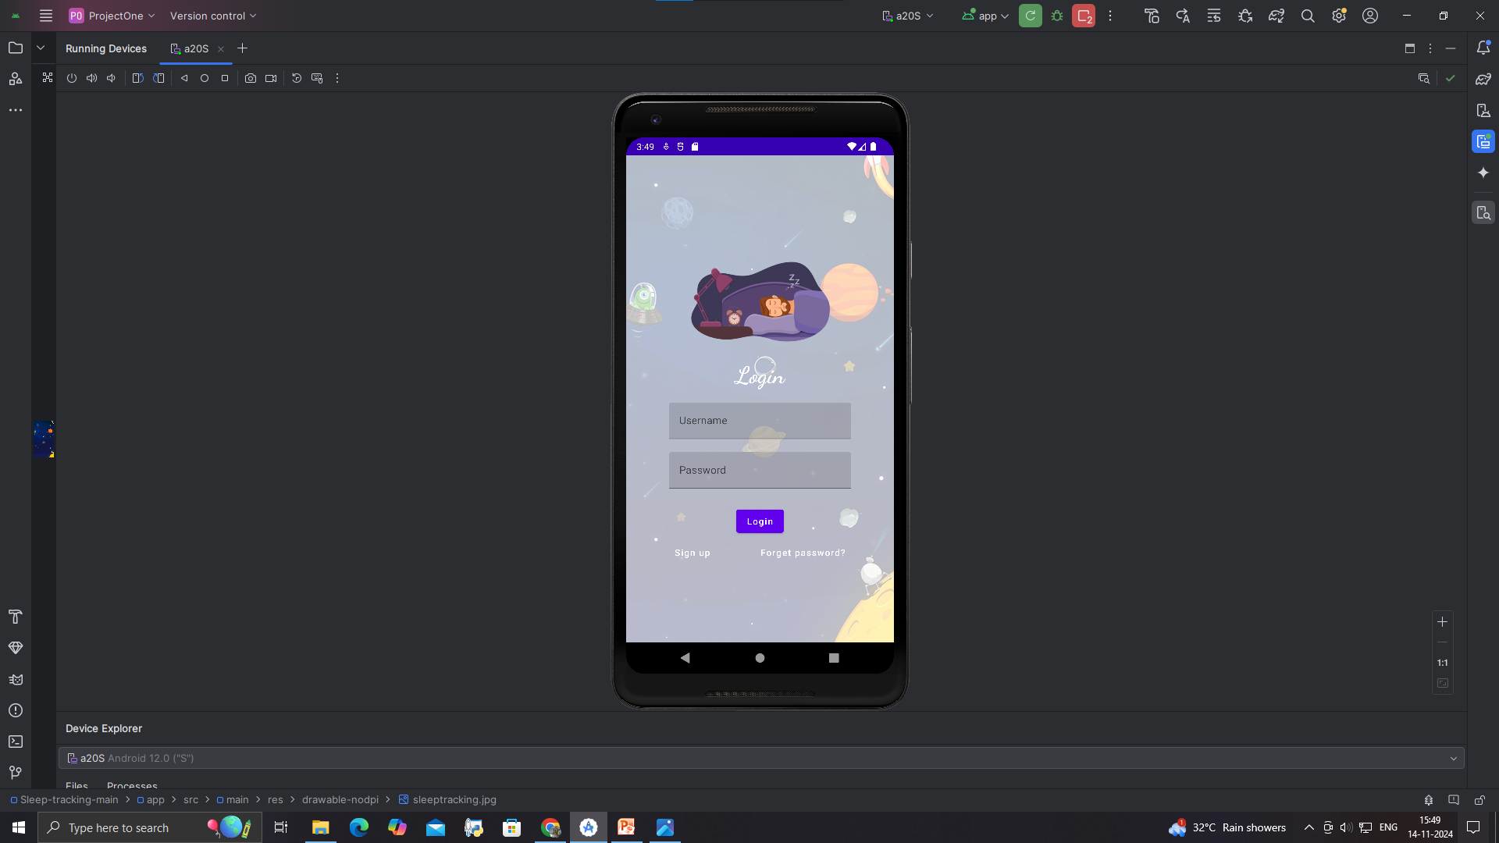
OUTPUT :

Slide 9
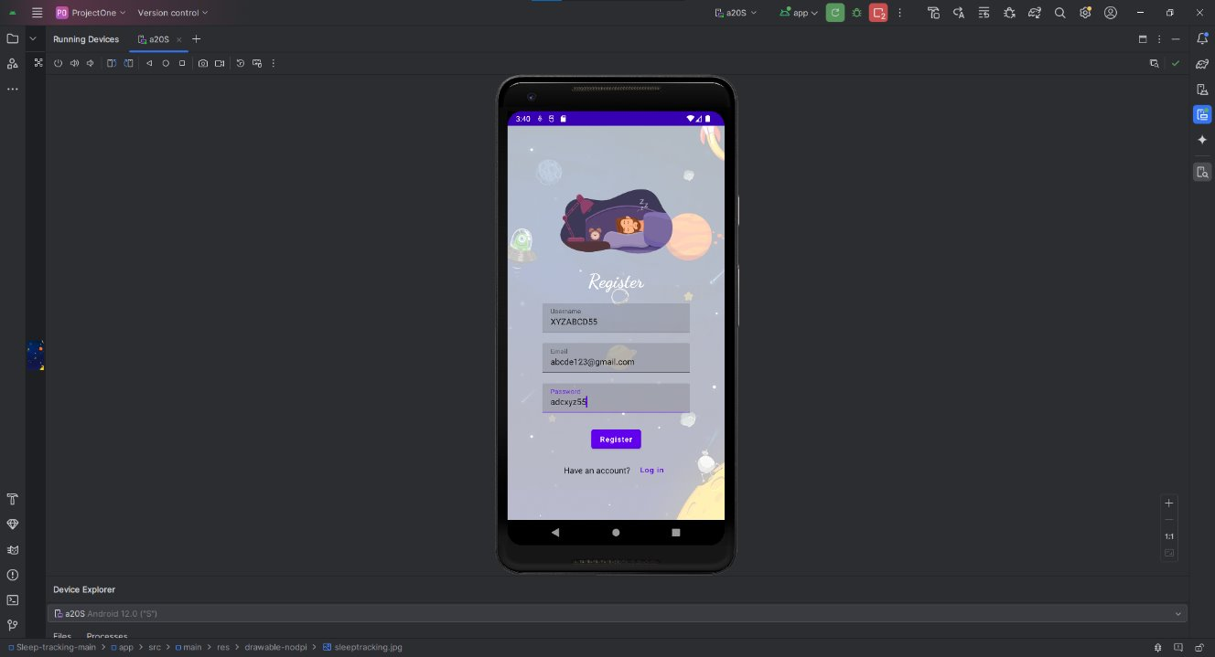

Slide 10
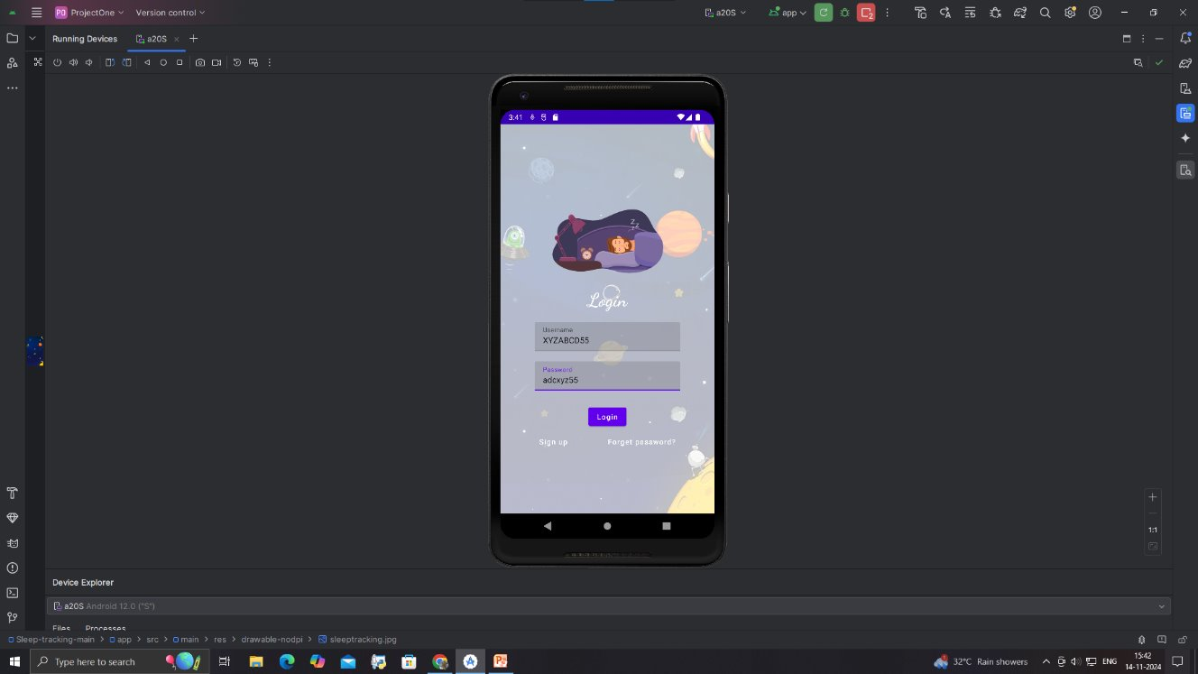

Slide 11
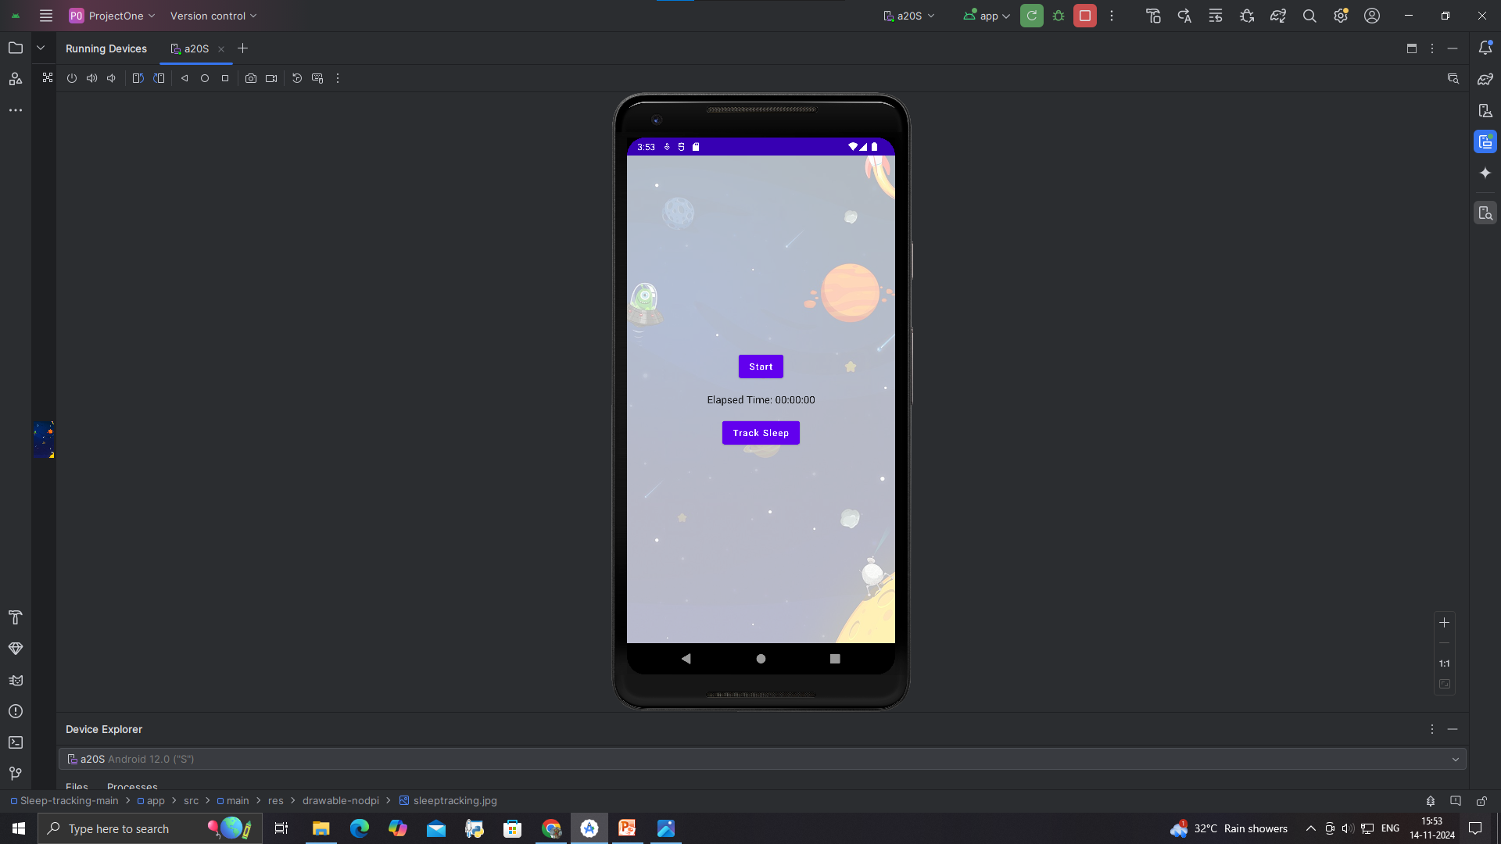

Slide 12
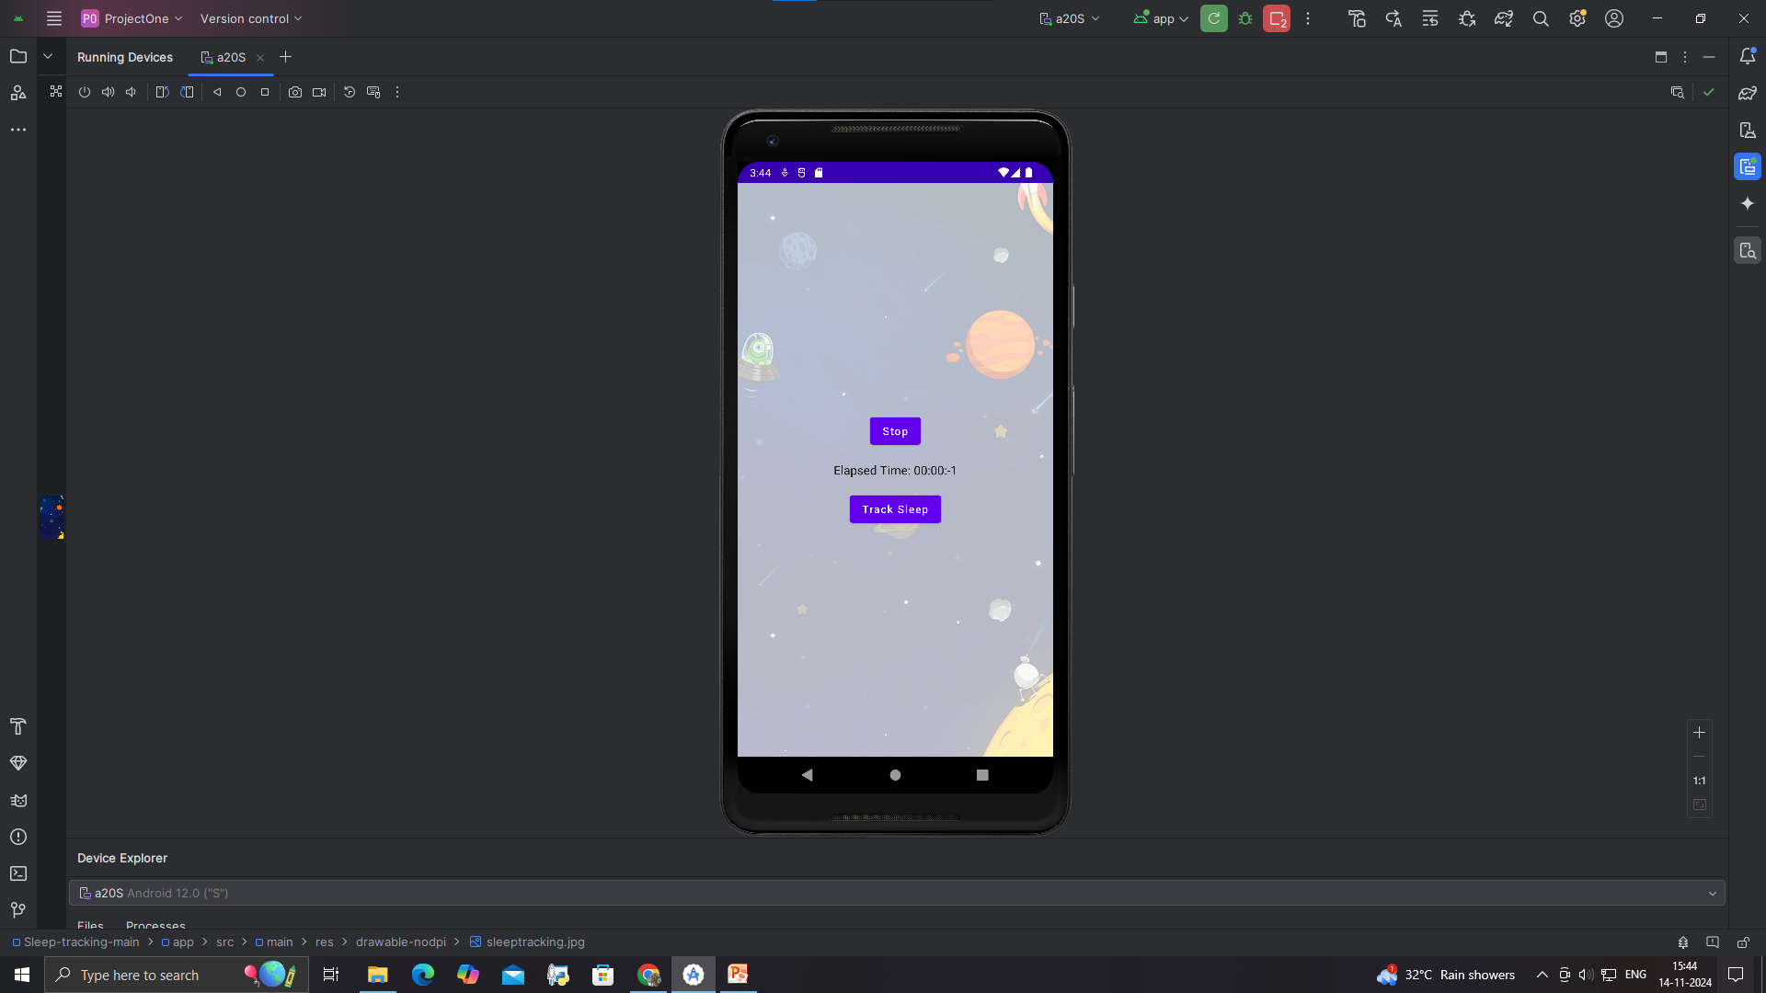

Slide 13
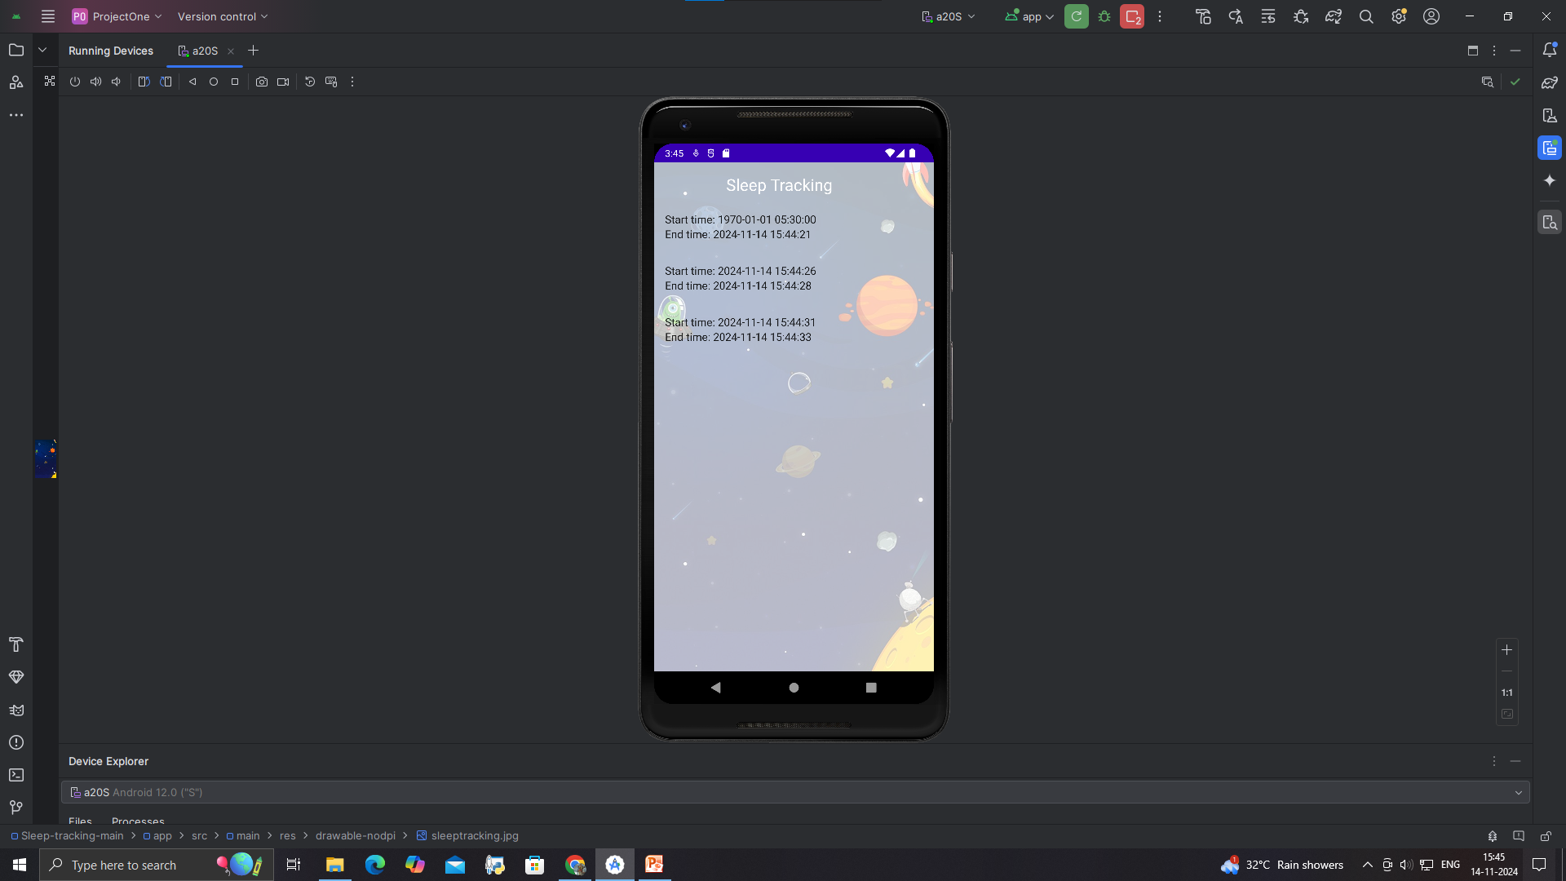

Slide 14
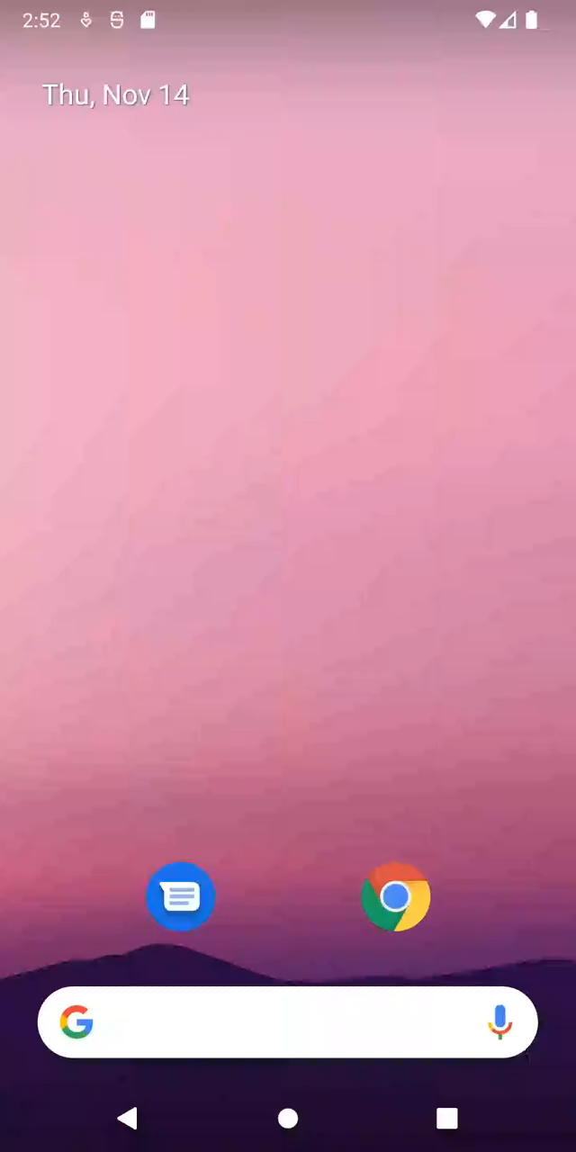
Demo video :

